Slide 1


FOOTBALL ‘SOCCER’ AT THE SUMMER OLYMPICS
Table 2
Adam Shabana
Chad Crossman
Ess Guernah
Marilyn Castro
Timothy Yip

Slide 2


Soccer was first introduced in the 1900 Summer Olympic Games. Held in Paris, France.
The original games ran from 05/14/1900- 10/28/1900
First ever gold medal for Men’s Soccer was awarded to Great Britain, Silver to France, and Bronze to Belgium.
Women’s Soccer wasn’t introduced until the 1996 Summer Olympics, which was held in Atlanta, Georgia.
With the United States winning Gold, China got Silver, and Brazil took home the Bronze Medal.
Soccer in the Olympics

Slide 3
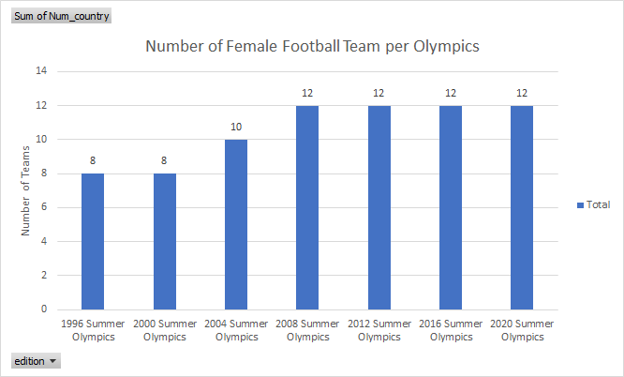
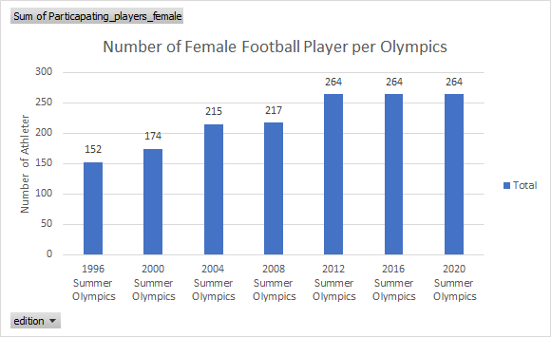
Female Football Player by Teams and Number of Athletes

Slide 4
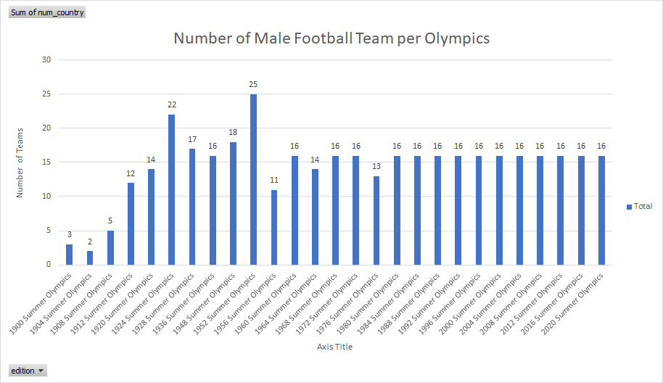
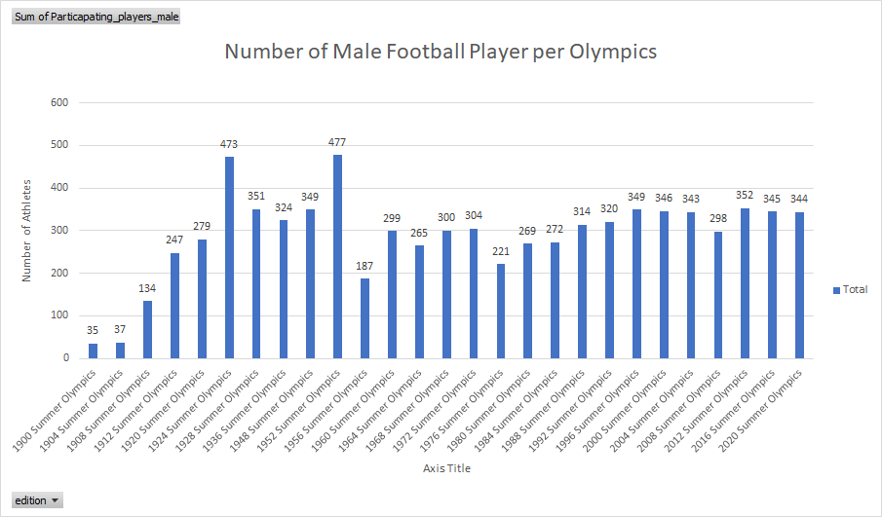
Male Football Player by Teams and Number of Athletes

Slide 5
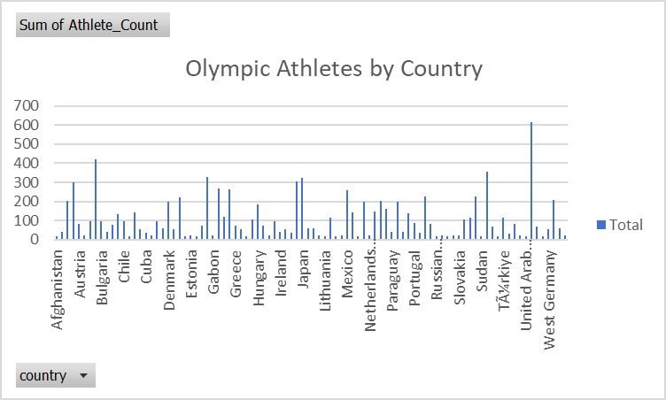


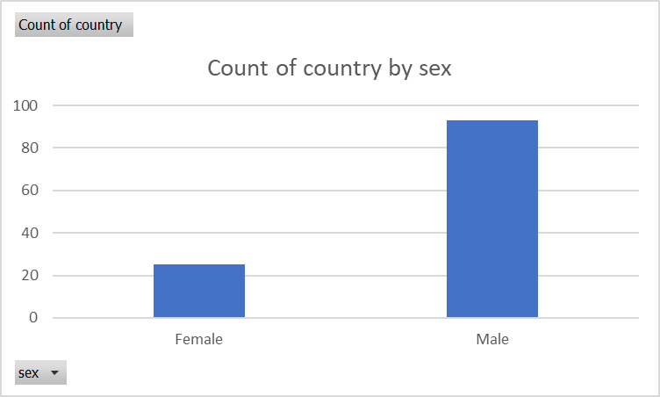
All Football Players on an Olympic Team

Slide 6
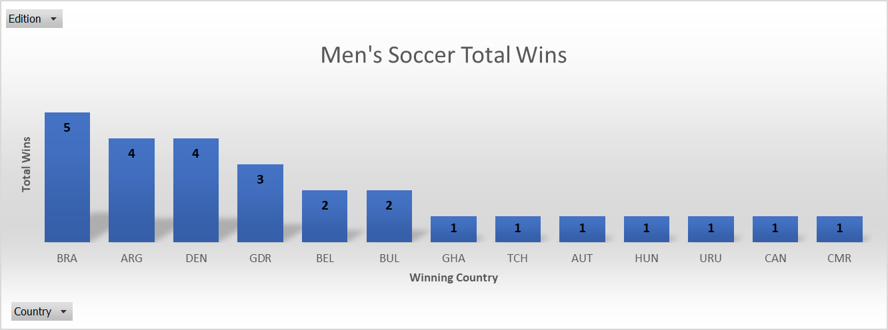
Which Country has won the most medals of all time?

Slide 7
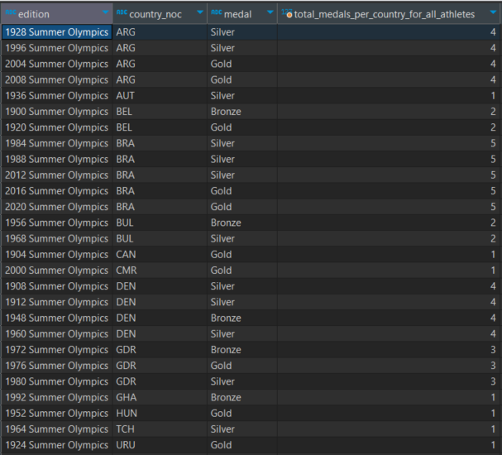

DBeaver Code
WITH cte AS
(
SELECT edition, country_noc,medal,
COUNT(medal) OVER(PARTITION BY country_noc) AS total_medals_per_country_for_all_athletes
FROM Olympic_Athlete_Event_Results
WHERE event = 'Football, Men'AND medal IN ('Gold','Bronze','Silver')
GROUP BY edition
)
SELECT country_noc,MAX(total_medals_per_country_for_all_athletes)
FROM cte;

